Slide 1
Presentation: E-commerce Customer Behavior Analysis
E-commerce Customer Behavior Analysis
From Customer Segmentation to Churn Prediction
Presented by
Liu Kun & Li Dan
file:///D:/ecommerce/presentation/presentation.html 1/ 17

Slide 2
Presentation: E-commerce Customer Behavior Analysis
Agenda 1. Introduction: Project Objectives & Methodology 2. Data Preparation: Cleaning & Feature Engineering 3. Descriptive Analysis: Customer Segmentation Findings 4. Predictive Analysis: Customer Churn Model Results 5. Strategic Recommendations & Conclusion
file:///D:/ecommerce/presentation/presentation.html 2/ 17

Slide 3
Presentation: E-commerce Customer Behavior Analysis
Part 1
Introduction & Methodology
file:///D:/ecommerce/presentation/presentation.html 3/17

Slide 4
Presentation: E-commerce Customer Behavior Analysis
 | 01 ^{Project} ^{Objectives}
 | Background In a competitive e-commerce landscape, understanding and retaining customers is critical for sustainable growth. This project aims to transform raw transactional data into actionable business intelligence. | Core Questions → Who are our customers? By segmenting users into distinct value groups. → Who might we lose? By proactively identifying customers at high risk of churning.
file:///D:/ecommerce/presentation/presentation.html 4/ 17

Slide 5
Presentation: E-commerce Customer Behavior Analysis
Part 2
Data Preparation
file:///D:/ecommerce/presentation/presentation.html 5/17

Slide 6
Presentation: E-commerce Customer Behavior Analysis
 | 02 ^{Data} ^{Cleaning} ^{Process}
 | This rigorous process ensures our analysis is built on a reliable and accurate data foundation.
Before Cleaning 1,067,371 Total Raw Records Contained missing Customer IDs Included returns & zero-price items Had duplicate entries
After Cleaning 779,425 High-Quality Records All records have a valid Customer ID Only positive quantity and price Duplicates removed
file:///D:/ecommerce/presentation/presentation.html 6/17

Slide 7
Presentation: E-commerce Customer Behavior Analysis
Part 3
Descriptive Analysis
file:///D:/ecommerce/presentation/presentation.html 7/ 17

Slide 8
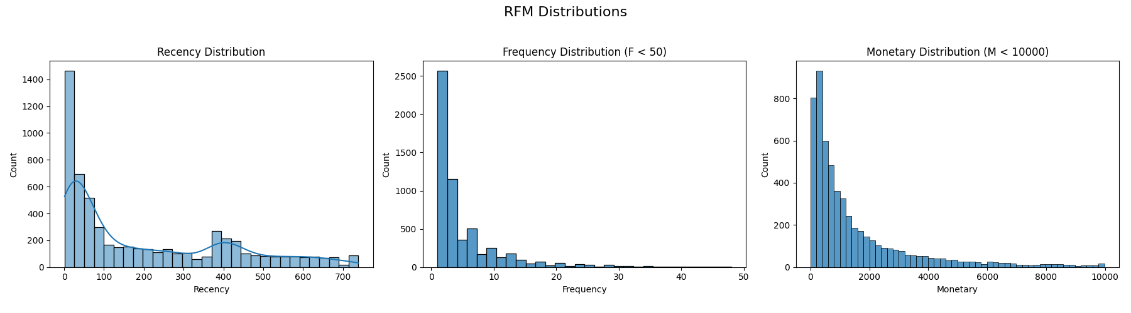
Presentation: E-commerce Customer Behavior Analysis
₀₃ ^{Understanding} ^{RFM} ^{Distributions}
Interpretation These histograms show the distribution of RFM values across all customers. Recency (R): The distribution is heavily concentrated on the left. This is a positive sign, indicating that a significant number of customers have purchased very recently (low Recency values), forming an active customer base. Frequency (F) & Monetary (M): Both distributions are heavily right-skewed. This classic retail pattern shows that the vast majority of customers purchase infrequently and spend little, while a small group of power users are responsible for high frequency and high spending.
file:///D:/ecommerce/presentation/presentation.html 8/17

Slide 9
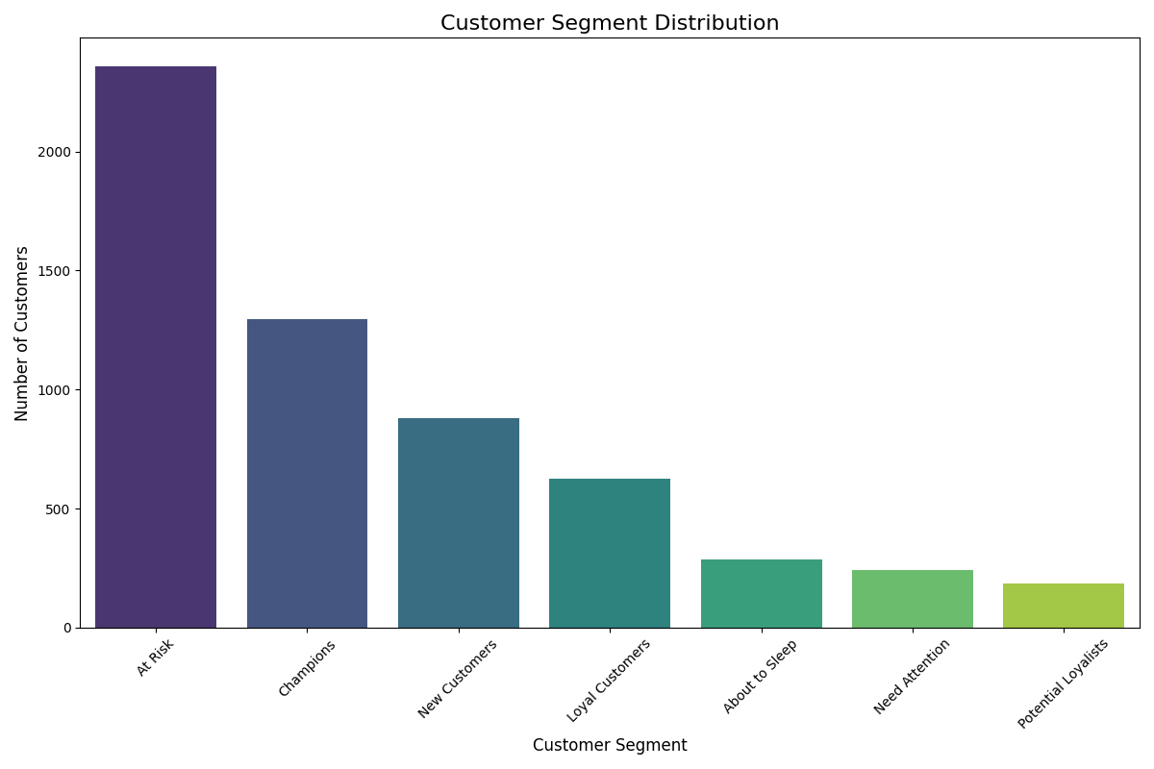
Presentation: E-commerce Customer Behavior Analysis
₀₃^{Finding:} ^{Customer} ^{Segment} ^{Distribution}
 | Interpretation This chart displays the final customer segments, providing a clear snapshot of our customer base's health. Key Challenge: The "At-Risk" segment is the largest, confirming that customer retention is the most critical issue to address. Core Strength: The business is supported by a strong foundation of "Champions" and "Loyal Customers" , who are the primary revenue drivers.
file:///D:/ecommerce/presentation/presentation.html 9/17

Slide 10
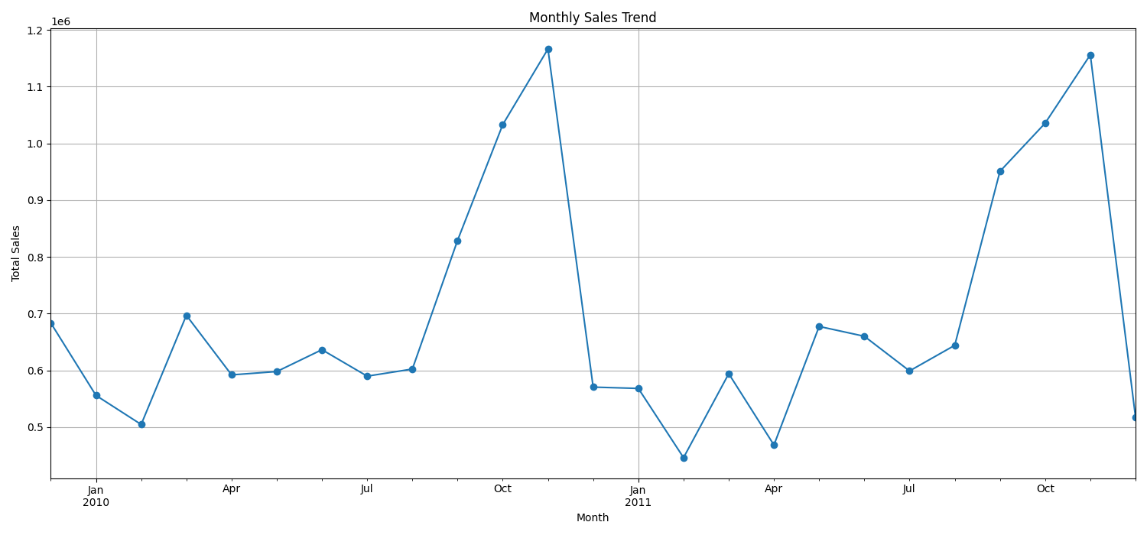
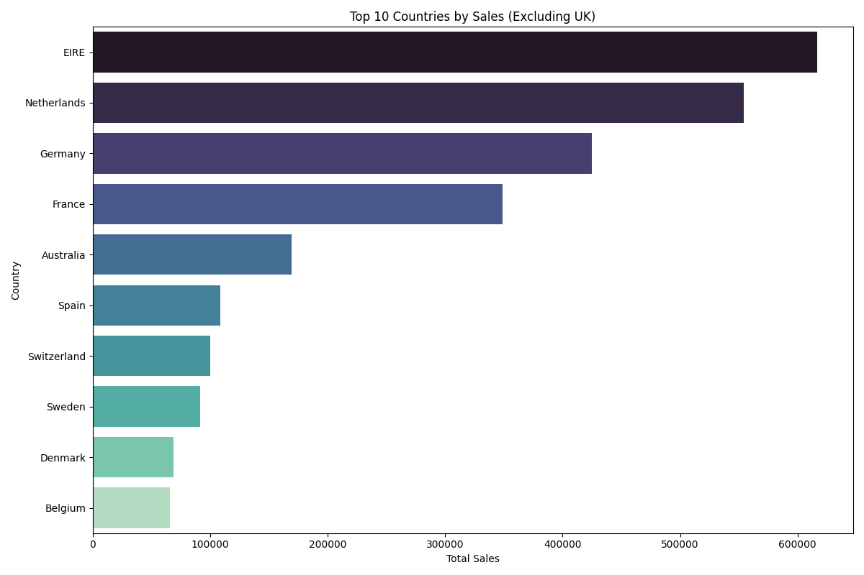
Presentation: E-commerce Customer Behavior Analysis
₀₃ ^{Finding:} ^{Sales} & ^{Geographic} ^{Patterns}
Monthly Sales Trend
Sales show strong seasonality, peaking in November, likely due to holiday shopping.
Top Markets (Excl. UK)
EIRE (Ireland) and the Netherlands are the largest secondary markets, representing key areas for international growth.
file:///D:/ecommerce/presentation/presentation.html 10/17

Slide 11
Presentation: E-commerce Customer Behavior Analysis
Part 4
Predictive Analysis
file:///D:/ecommerce/presentation/presentation.html 11/ 17

Slide 12
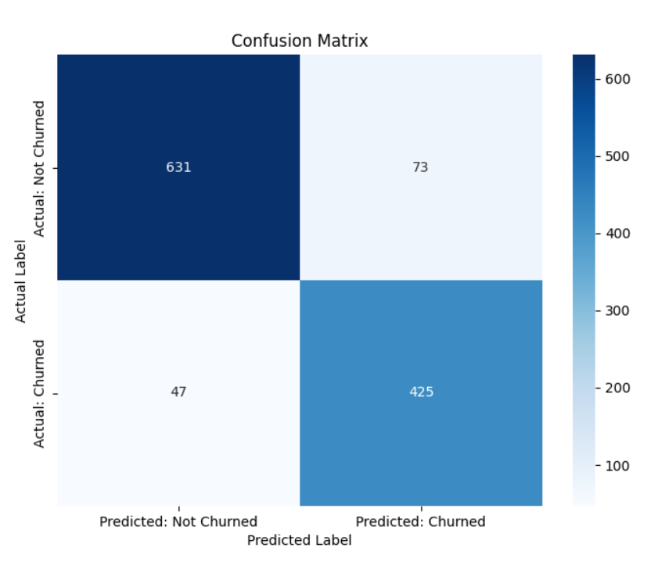
Presentation: E-commerce Customer Behavior Analysis
₀₄^{Finding:} ^{Predictive} ^{Model} ^{Performance}
 |  |  | Interpretation We trained a Logistic Regression model to predict churn. The confusion matrix shows its performance on unseen test data. High Accuracy: The model achieves an overall accuracy of approximately 90%. Excellent Recall: More importantly, the model has a Recall of 90% for the churn class. This means it successfully identifies 9 out of 10 customers who are actually going to churn, making it highly effective for targeted retention campaigns. Business Value: This predictive power allows the business to move from being reactive to proactive, saving customers before they are lost.
file:///D:/ecommerce/presentation/presentation.html 13/17

Slide 13
Presentation: E-commerce Customer Behavior Analysis
Part 5
Recommendations & Conclusion
file:///D:/ecommerce/presentation/presentation.html 14/ 17

Slide 14
Presentation: E-commerce Customer Behavior Analysis
05 ^{Actionable} ^{Recommendations}
For Champions Goal: Reward & Retain Implement a VIP program with exclusive benefits. Encourage them to become brand advocates. | For At-Risk Customers Goal: Proactive Reactivation Use the predictive model to target this group. Launch " win-back" campaigns with personalized discounts. | For New Customers Goal: Nurture & Convert Create a welcome email series to build engagement. Offer an incentive for their second purchase.
file:///D:/ecommerce/presentation/presentation.html 15/17

Slide 15
Presentation: E-commerce Customer Behavior Analysis
05 ^{Conclusion} & ^{Future} ^{Work}
Conclusion This project successfully demonstrates an end-to-end data analysis pipeline. We have moved from raw data to descriptive and predictive insights, providing clear, data- driven strategies to enhance customer retention and drive business growth. | Future Work Enhance Model: Use more features & advanced algorithms (XGBoost). Basket Analysis: Analyze which products are bought together. CLV Prediction: Forecast total Customer Lifetime Value.
file:///D:/ecommerce/presentation/presentation.html 16/17

Slide 16
Presentation: E-commerce Customer Behavior Analysis
ThankYou
Q & A
file:///D:/ecommerce/presentation/presentation.html 17/ 17

